Slide 1

Lea ning
Week 1: Intro to R and R studio

Slide 2
What’s on for today
R Studio setup and orientation
YOUR TURN: Set up R studio on your computer
My first script
An intro to syntax
Basic R objects
Organizing R objects
Navigating R objects
YOUR TURN: Your first script

Slide 3
R Studio Orientation

Slide 4
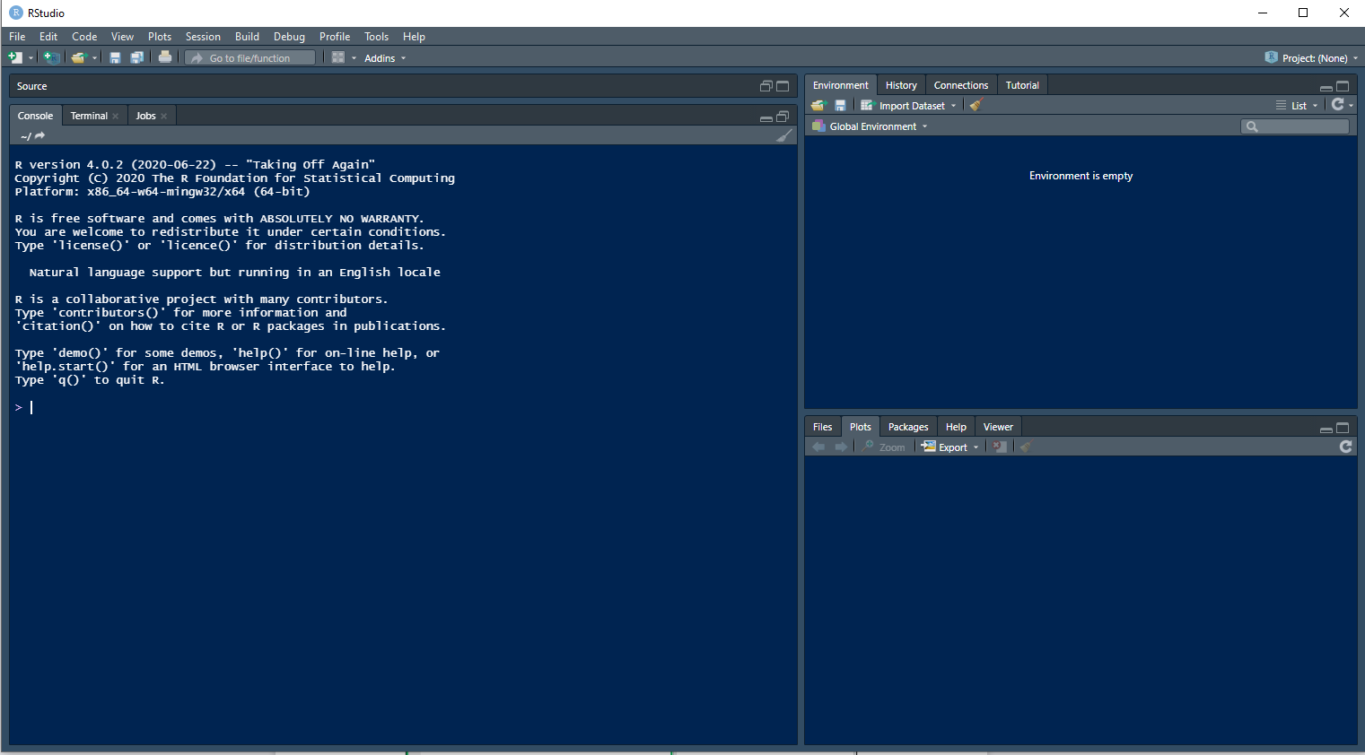
2. The Environment
All of the variables you have created are shown and organized here. These can all be saved and loaded later on.
File: current file system
The Console
Your commands are executed here, and any results are shown in this box
Plots: plots and graphs are displayed here
Packages: shows installed packages / those available to install
Help: documentation for all commands

Slide 5
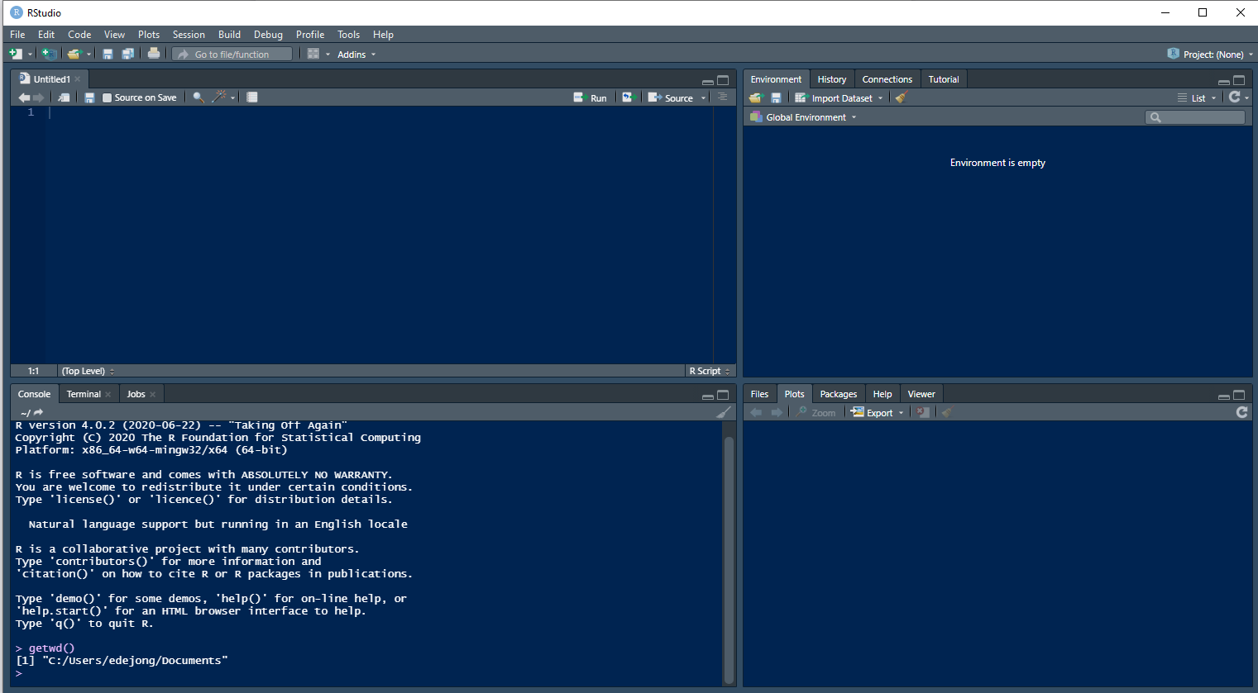
3. Your script
Use this to keep a record of your code

Slide 6
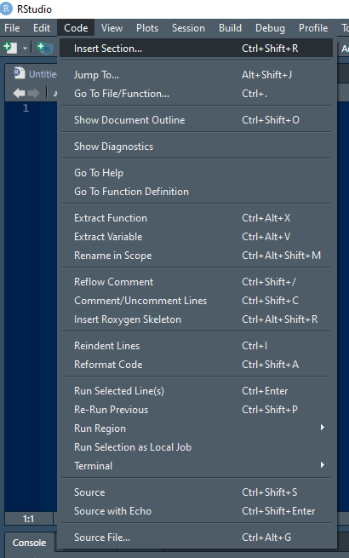
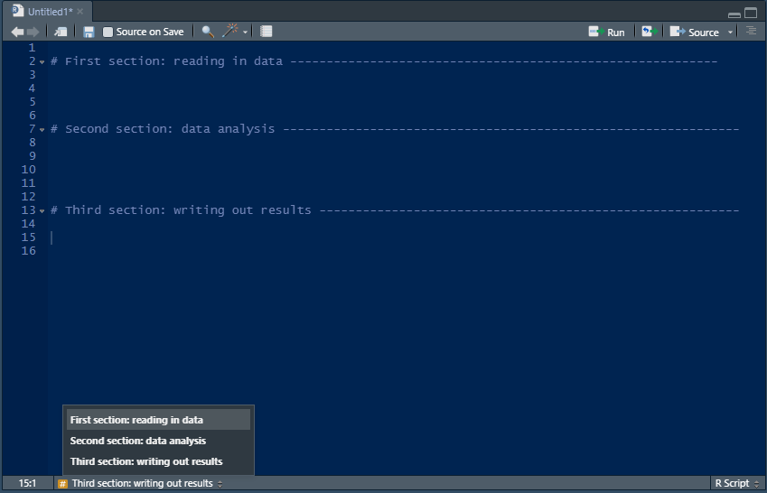
Use "sections" to keep your code organised.
Sections are collapsible/expandable regions of code
You can navigate through your sections here

Slide 7
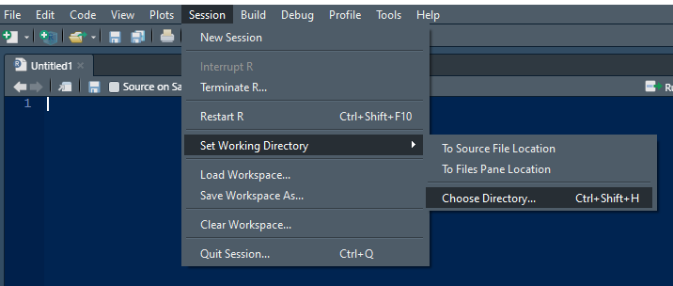
Working directory: the folder that you want to work from
Contains the files you want to read into R
Will be the location that any results are exported to

Slide 8
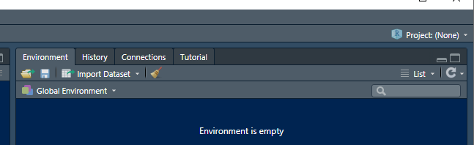
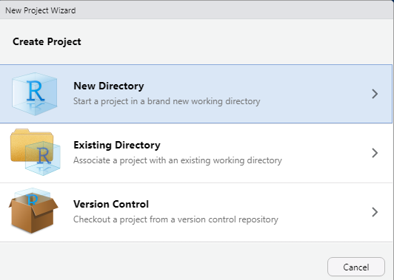
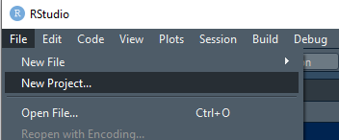
Creating new “projects” is a good way to keep organized when working on multiple datasets
No project is open when you start R Studio
Create a new project under file → new project
“New directory” makes a working directory for the project, a place to store all associated data files

Slide 9
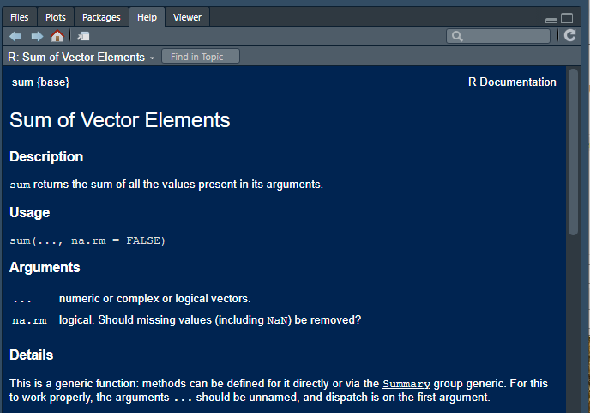
A few other basics
Comments
The # symbol indicates a comment, or a line of text that is not evaluated as code
Use comments to help keep track of what your code means
Run a command using CTRL+Enter (curser can be anywhere in the line of code)
Help
Use ?function to open the help page for any function e.g.
?sum
The help page is always formatted the same
Description of the function
An example showing default values for arguments
Description of each argument (parameter)
Details of the function
Description of the value returned
Worked example

Slide 10
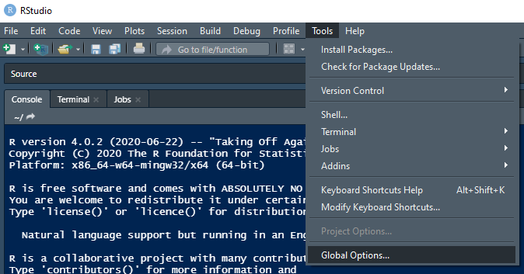
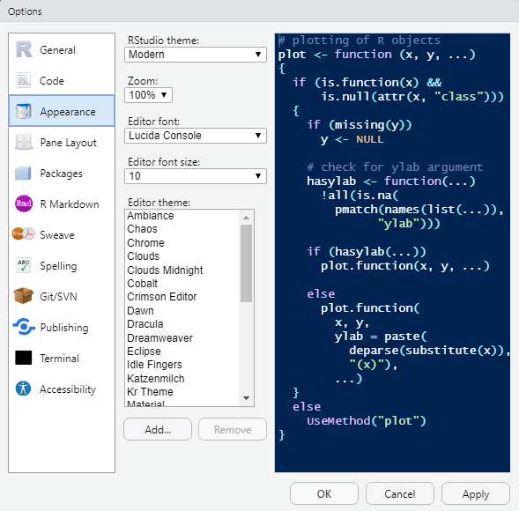
Changing the aesthetics

Slide 11
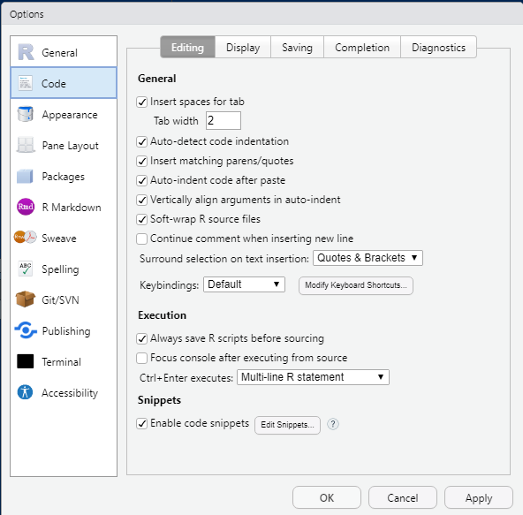
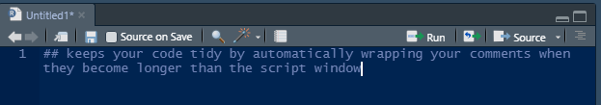
Soft-wrapping source code

Slide 12
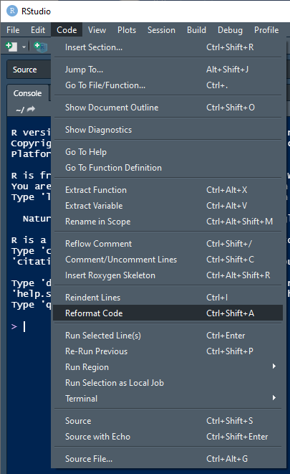
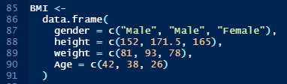
Reformat Code (Ctrl+Shift+A): keeps everything tidy!
Before
After

Slide 13
YOUR TURN: let’s set up our first project

Slide 14
Part II: My First Script

Slide 15
Syntax, “Syntax”, $intax
R is a computer language
Like any other languages, the fist step is learning the basic syntax
Sometimes this is intuitive
Other times, it’s just rules to remember (fish vs. ghish anyone?)
We will start be introducing the basic types of syntax (objects) used in R

Slide 16
R Objects: The very basics
There are four basic types of objects in R
Characters
Factors
Numbers (Integers)
Non-executable notes
Examples
“Four”
Four
4.00 / 4
#ThisIsNumberFour

Slide 17
R Objects: How they are organized
Examples
4
There are four basic ways to organize these objects
A value
A vector
A data frame
A list
1,2,3,4
A | B
1 | 2
2 | 3
3 | 4
4 | 5
4
1,2,3,4

Slide 18
R Objects: How they are navigated
The fun of learning R starts with the syntax of navigating your objects
Square brackets are used for navigation
Vectors: [<coordinate of your object>]
Data Frames: [row #, column #]

Slide 19
R Objects: How they are used?
In R, Functions are used to do things with objects. We will spend more time on functions as the course progresses. For now, know that all of R’s usefulness is because of functions applied to objects to reach a goal.
In Excel, functions are used to calculate things
(e.g. =AVERAGE(A1:A9))
In R, functions are always indicated with ( )
E.G. mean( ), sd( )

Slide 20
YOUR TURN: Let’s make some objects

